Slide 1
Chapter 4 Introduction to Cascading Style Sheets (CSS)
簡廷因 Ting-Ying Chien
2024.10.09

Slide 2
Outline
Introduction
Inline Styles
Embedded Style Sheets
Confliction Styles
Linking External Style Sheets
Positioning Elements: Absolute Positioning, z-index
Positioning Elements: Absolute Positioning, span
Backgrounds
Element Dimensions
Box Model and Test Flow

Slide 3
Outline
Drop-Down Menus
Media Types and Media Queries
User Style Sheets

Slide 4
站在巨人的肩膀上
Free CSS template
http://www.templatemo.com/
http://www.oswd.org/
http://templated.co/
http://www.myfreecsstemplates.com/
http://www.free-css.com/
http://www.free-css-templates.com/
https://www.freewebtemplates.com/css-templates/

Slide 5
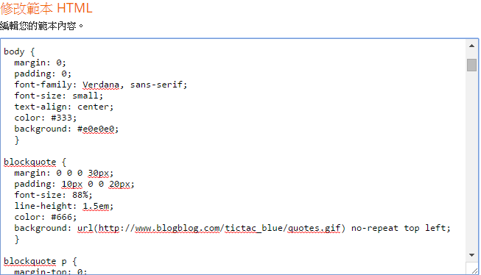
Example
Blogger

Slide 6
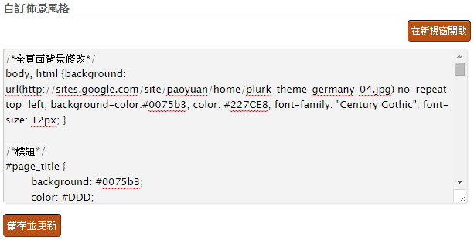
Example
Plurk

Slide 7
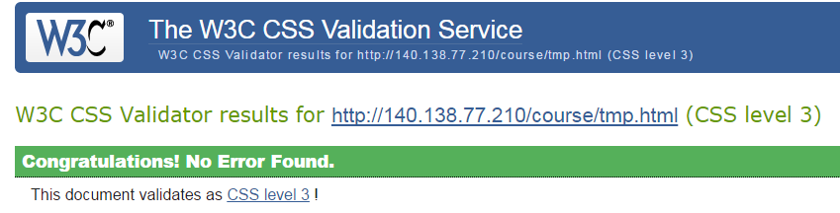
Introduction
Cascading Style Sheets 3 (CSS3)
Used to specify the presentation of elements separately from the structure of the document.
CSS validator
http://jigsaw.w3.org/css-validator/

Slide 8
Inline Styles
Inline style
declare an individual element’s format using the HTML5 attribute style.
Each CSS property is followed by a colon (:) and the value of the attribute
Multiple property declarations are separated by a semicolon(;)

Slide 9
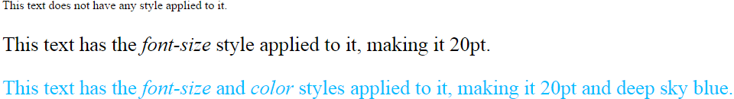
Inline Styles
<!DOCTYPE html>
<html>
<head>
<meta charset = "utf-8">
<title>Inline Styles</title>
</head>
<body>
<p>This text does not have any style applied to it.</p>
<p style = "font-size: 20pt;">This text has the
<em>font-size</em> style applied to it, making it 20pt.
</p>
<p style = "font-size: 20pt; color: deepskyblue;">
This text has the <em>font-size</em> and
<em>color</em> styles applied to it, making it
20pt and deep sky blue.</p>
</body>
</html>
Each CSS property is followed by a colon (:) and the value of the attribute
Multiple property declarations are separated by a semicolon(;)

Slide 10
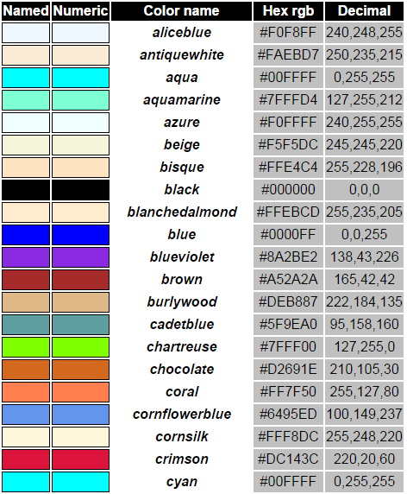
Inline Styles
color property sets text color
Color names and hexadecimal codes may be used as the color property value.
Ref: http://www.w3.org/TR/css3-color/

Slide 11
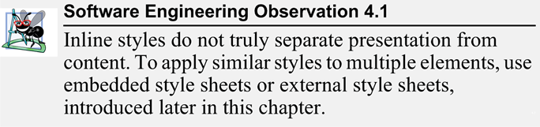
Inline Styles

Slide 12
Embedded Style Sheets
A second technique for using style sheets is embedded style sheets, which enable you to embed a CSS3 document in an HTML5 document’s head section.

Slide 13

Embedded Style Sheets
<!DOCTYPE html>
<html>
<head>
<meta charset = "utf-8">
<title>Embedded Style Sheet</title>
<style type = "text/css">
em { font-weight: bold;
color: black; }
h1 { font-family: tahoma, helvetica, sans-serif; }
p { font-size: 12pt;
font-family: arial, sans-serif; }
.special { color: purple; }
</style>
</head>
<body>
<h1 class = "special">Deitel & Associates, Inc.</h1>
<p>Deitel & Associates, Inc. is an authoring and corporate training organization
specializing in programming languages, Internet and web technology, iPhone and
Android app development, and object technology education.</p>
<h1>Clients</h1>
<p class = "special"> The company's clients include many <em>Fortune 1000 companies</em>,
government agencies, branches of the military and business organizations.</p>
</body>
</html>
em : emphasized
font-weight : 字體粗細
color : 字體顏色
font-family : 字型
font-size : 字體大小
放在head內

Slide 14
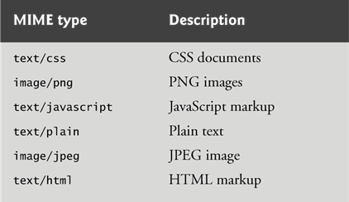
Embedded Style Sheets
The style Element and MIME Types
Styles that are placed in a style element use selectors to apply style elements throughout the entire document
style element type attribute specifies the MIME type (the specific encoding format) of the style sheet. Style sheets use text/css.
Ref: http://www.iana.org/assignments/media-types/media-types.xhtml

Slide 15
Embedded Style Sheets
The style sheet’s body declares the CSS rules for the style sheet.
To achieve the separation between the CSS3 code and the HTML5 that it styles, we’ll use a CSS selector to specify the elements that will be styled according to a rule.
Each rule body in a style sheet is enclosed in curly braces ({ and }).
<style type = "text/css">
em { font-weight: bold;
color: black; }
h1 { font-family: tahoma, helvetica, sans-serif; }
p { font-size: 12pt;
font-family: arial, sans-serif; }
.special { color: purple; }
</style>

Slide 16
Embedded Style Sheets
font-weight property specifies the "boldness" of text.
Possible values are
bold
normal (the default)
bolder (bolder than bold text)
lighter (lighter than normal text)
Boldness also can be specified with multiples of 100, from 100 to 900 (e.g., 100, 200, …, 900). Text specified as normal is equivalent to 400, and bold text is equivalent to 700
Ref: http://www.w3schools.com/cssref/pr_font_weight.asp

Slide 17
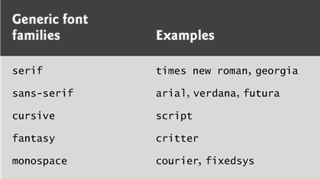
Embedded Style Sheets
font-family property specifies the name of the font to use.
Generic font families allow authors to specify a type of font instead of a specific font, in case a browser does not support a specific font.
The font-family property can hold several font names as a "fallback" system. If the browser does not support the first font, it tries the next font.

Slide 18
Embedded Style Sheets
font-size property specifies the size used to render the font.
You can specify a point size or a relative value such as xx-small, x-small, small, smaller, medium, large, larger, x-large and xx-large.
Relative font-size values are preferred over points, because an author does not know the specific measurements of each client’s display.
Relative values permit more flexible viewing of web pages.

Slide 19

Embedded Style Sheets
font-style
specifies the font style for a text
none
italic
oblique
Ref : https://css-tricks.com/almanac/properties/f/font-style/

Slide 20
Embedded Style Sheets
Style-class declarations are preceded by a period (.).
They define styles that can be applied to any element.
You can also declare id selectors.
If an element in your page has an id, you can declare a selector of the form #elementId to specify that element’s style.

Slide 21

Embedded Style Sheets
<!DOCTYPE html>
<html>
<head>
<meta charset = "utf-8">
<title>Embedded Style Sheet</title>
<style type = "text/css">
em { font-weight: bold;
color: black; }
h1 { font-family: tahoma, helvetica, sans-serif; }
p { font-size: 12pt;
font-family: arial, sans-serif; }
.special { color: purple; }
#tmp { color: red; }
</style>
</head>
<body>
<h1 class = "special">Deitel & Associates, Inc.</h1>
<p>Deitel & Associates, Inc. is an authoring and corporate training organization
specializing in programming languages, Internet and web technology,<i id ="tmp">
iPhone and Android </i>app development, and object technology education.</p>
<h1>Clients</h1>
<p class = "special"> The company's clients include many <em>Fortune 1000 companies</em>,
government agencies, branches of the military and business organizations.</p>
</body>
</html>

Slide 22
Embedded Style Sheets
In many cases, the styles applied to an element (the parent or ancestor element) also apply to the element’s nested elements (child or descendant elements).
Multiple values of one property can be set or inherited on the same element, so the browser must reduce them to one value for that property per element before they’re rendered.
We discuss the rules for resolving these conflicts in the next section.

Slide 23
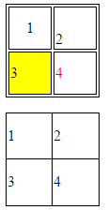
Table CSS
<!DOCTYPE html>
<html>
<head>
<meta charset = "utf-8"><title>Table</title>
<style type="text/css">
table,th,td { border:1px solid black; }
table { width : 100px ; height : 100px; }
#table2 { border-collapse: collapse; }
</style>
</head>
<body>
<table id = "table1" >
<tr>
<td style = "text-align: center;">1</td>
<td style = "vertical-align: bottom;">2</td>
</tr>
<tr>
<td style = "background-color: yellow;">3</td>
<td style = "color:red">4</td>
</tr>
</table>
<p></p>
<table id = "table2">
<tr><td>1</td><td>2</td></tr>
<tr><td>3</td><td>4</td></tr>
</table>
</body>
</html>
border
1px: 寬度
solid : 實線
black : 黑色
width : 寬
height : 高
border-collapse: 邊框單/雙線
collapse : 單線
text-align : 文字水平對齊
right, center, left
vertical-align : 文字垂直對齊
top, middle, bottom
background-color : 底色
color : 文字顏色

Slide 24
Exercise
color : blue
 | font-family: courier
 | font-size : 18 pt
text-align : center
border-collapse: collapse

Slide 25
Conflicting Styles
Styles may be defined by a user, an author or a user agent.
User style sheet
A user agent may also allow a user to create a customized set of styles to use by default, or for specific documents.
Author style sheets
that are linked to the document via a link element, specified using a style element within the document’s head element, or specified within an element style attribute
User Agent (typically a web browser) style sheets
the default sets of declarations applied by the user agent
Priority
author > user > user agent

Slide 26
Conflicting Styles
Most styles defined for parent elements are also inherited by child (nested) elements.
<style type = "text/css">
em { font-weight: bold;
color: black; }
h1 { font-family: tahoma, helvetica, sans-serif; }
p { font-size: 12pt;
font-family: arial, sans-serif; }
.special { color: purple; }
</style>
<p class = "special"> The company's clients include many <em>Fortune 1000 companies</em>,
government agencies, branches of the military and business organizations.</p>
p
em
<em>
-> font-size: 12pt;
-> font-family: arial, sans-serif;
-> color: purple;
<p class = "special">
-> font-size: 12pt;
-> font-family: arial, sans-serif;
-> color: purple;
<em>
-> font-weight: bold;
-> color: black;

Slide 27
Conflicting Styles
Properties defined for child and descendant elements have a higher specificity than properties defined for parent and ancestor elements.
Conflicts are resolved in favor of properties with a higher specificity, so the child’s styles take precedence.

Slide 28
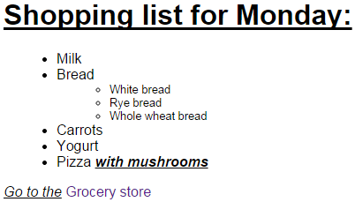
Conflicting Styles
<!DOCTYPE html>
<html>
<head>
<meta charset = "utf-8">
<title>More Styles</title>
<style type = "text/css">
body { font-family: arial, helvetica, sans-serif; }
a.nodec { text-decoration: none; }
a:hover { text-decoration: underline; }
li em { font-weight: bold; }
h1, em { text-decoration: underline; }
ul { margin-left: 20px; }
ul ul { font-size: .8em; }
</style>
</head>
<body>
<h1>Shopping list for Monday:</h1>
<ul>
<li>Milk</li>
<li>Bread
<ul>
<li>White bread</li>
<li>Rye bread</li>
<li>Whole wheat bread</li>
</ul>
</li>
<li>Carrots</li>
<li>Yogurt</li>
<li>Pizza <em>with mushrooms</em></li>
</ul>
<p><em>Go to the</em>
<a class = "nodec" href = "http://www.deitel.com">Grocery store</a>
</p>
</body>
</html>
text-decoration : the decoration added to text
none
underline : 文字之下
overline : 文字之上
line-through : 文字之中
:hover 滑鼠移到該element才啟動
margin-left : 距左邊界 20 px

Slide 29
Conflicting Styles
Pseudoclasses
A pseudo-class is used to define a special state of an element.
E.g :
a:link // unvisited links
a:visited // visited links
a:hover // on mouse over
a:active // the active link
Note : a:hover MUST come after a:link and a:visited, a:active MUST come after a:hover

Slide 30
Conflicting Styles
Relative length measurements:
px
Pixels - size varies depending on screen resolution
em
1em is equal to the current font size
usually the height of a font’s uppercase M
ex
1ex is the x-height of a font (x-height is usually about half the font-size)
%
Percentages of the font’s default size

Slide 31
Conflicting Styles
Absolute-length measurements (units that do not vary in size):
in (inches)
cm (centimeters)
mm (millimeters)
pt (points; 1 pt = 1/72 in)
pc (picas; 1 pc = 12 pt)

Slide 32
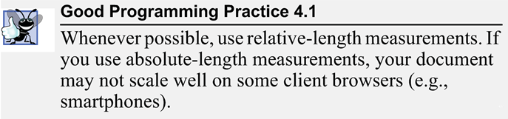
Conflicting Styles

Slide 33
Linking External Style Sheets
<!DOCTYPE html>
<html>
<head>
<meta charset="utf-8">
<title>Linking External Style Sheets</title>
<link rel = "stylesheet" type = "text/css" href = "styles.css">
</head>
<body>
<h1>Shopping list for <em>Monday</em>:</h1>
<ul>
<li>Milk</li>
<li>Bread
<ul>
<li>White bread</li>
<li>Rye bread</li>
<li>Whole wheat bread</li>
</ul>
</li>
<li>Carrots</li>
<li>Yogurt</li>
<li>Pizza <em>with mushrooms</em></li>
</ul>
<p><em>Go to the</em>
<a class = "nodec" href = "http://www.deitel.com"> Grocery store</a>
</p>
</body>
</html>
styles.css
/* styles.css */
body { font-family: arial, helvetica, sans-serif; }
a.nodec { text-decoration: none; }
a:hover { text-decoration: underline; }
li em { font-weight: bold; }
h1, em { text-decoration: underline; }
ul { margin-left: 20px; }
ul ul { font-size: .8em; }

Slide 34
Linking External Style Sheets
link element
Uses rel attribute to specify a relationship between two documents
rel attribute declares the linked document to be a stylesheet for the document
type attribute specifies the MIME type of the related document
href attribute provides the URL for the document containing the style sheet

Slide 35
Linking External Style Sheets
External style sheets are separate documents that contain only CSS rules.
Help create a uniform look for a website
Separate pages can all use the same styles.
Modifying a single style-sheet file makes changes to styles across an entire website (or to a portion of one).
When changes to the styles are required, you need to modify only a single CSS file to make style changes across all the pages that use those styles. This concept is sometimes known as skinning.

Slide 36
Positioning Elements: Absolute Positioning, z-index
CSS position property
Allows absolute positioning, which provides greater control over where on a page elements reside
Specifying an element’s position as absolute removes it from the normal flow of elements on the page and positions it according to distance from the top, left, right or bottom margin of its parent element

Slide 37
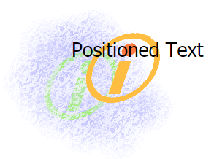


Positioning Elements: Absolute Positioning, z-index
<!DOCTYPE html>
<html>
<head>
<meta charset = "utf-8">
<title>Absolute Positioning</title>
<style type = "text/css">
.background_image { position: absolute;
top: 0px;
left: 0px;
z-index: 1; }
.foreground_image { position: absolute;
top: 25px;
left: 100px;
z-index: 2; }
.text { position: absolute;
top: 25px;
left: 100px;
z-index: 3;
font-size: 20pt;
font-family: tahoma, geneva, sans-serif; }
</style>
</head>
<body>
<p><img src = "background_image.png" class = "background_image"
alt = "First positioned image" /></p>
<p><img src = "foreground_image.png" class = "foreground_image"
alt = "Second positioned image" /></p>
<p class = "text">Positioned Text</p>
</body>
</html>
foreground_image.png
background_image.png
Position : position an element
Z-index : the stack order of an element

Slide 38
Positioning Elements: Absolute Positioning, z-index
Position : position an element
static : positioned element is always positioned according to the normal flow of the page.
fixed: positioned relative to the browser window
relative: positioned relative to its normal position
absolute : positioned relative to the first parent element
Z-index : the stack order of an element
An element with greater stack order is always in front of an element with a lower stack order.
If two positioned elements overlap without a z-index specified, the element positioned last in the HTML code will be shown on top.

Slide 39
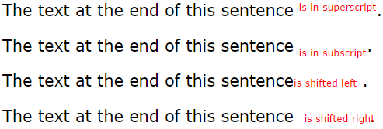
Positioning Elements: Relative Positioning, span
<!DOCTYPE html>
<html>
<head>
<meta charset = "utf-8">
<title>Relative Positioning</title>
<style type = "text/css">
p { font-size: 1.3em;
font-family: verdana, arial, sans-serif; }
span { color: red;
font-size: .6em;
height: 1em; }
.super { position: relative;
top: -1ex; }
.sub { position: relative;
bottom: -1ex; }
.shiftleft { position: relative;
left: -1ex; }
.shiftright { position: relative;
right: -1ex; }
</style>
</head>
<body>
<p>The text at the end of this sentence
<span class = "super">is in superscript</span>.</p>
<p>The text at the end of this sentence
<span class = "sub">is in subscript</span>.</p>
<p>The text at the end of this sentence
<span class = "shiftleft">is shifted left</span>.</p>
<p>The text at the end of this sentence
<span class = "shiftright">is shifted right</span>.</p>
</body>
</html>

Slide 40
Positioning Elements: Relative Positioning, span
Inline-level elements
Do not change the flow of the document
img, a, em, strong, span
Block-level elements
Displayed on their own line
Have virtual boxes around them
p,h1 … h6, div

Slide 41
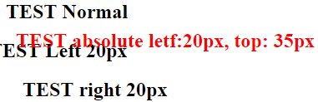
Exercise
Hint :
position : relative
position : absolute
Font-size: 24px

Slide 42
Backgrounds
CSS can control the backgrounds of block-level elements by adding:
Colors
Images

Slide 43
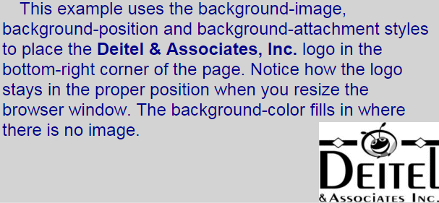
Backgrounds
<!DOCTYPE html>
<html>
<head>
<meta charset = "utf-8">
<title>Background Images</title>
<style type = "text/css">
body {background-image : url(logo.png);
background-position: bottom right;
background-repeat: no-repeat;
background-attachment: fixed;
background-color: LightGrey }
p { font-size: 18pt;
color: DarkBlue;
text-indent: 1em;
font-family: arial, sans-serif; }
.dark { font-weight: bold; }
</style>
</head>
<body>
<p>
This example uses the background-image, background-position and background-
attachment styles to place the <span class = "dark">Deitel & Associates, Inc.</span>
logo in the bottom-right corner of the page. Notice how the logo stays in the proper
position when you resize the browser window. The background-color fills in where
there is no image.
</p>
</body>
</html>
text-indent: 首行縮排

Slide 44

Backgrounds
background-image
Specifies the URL of the image, in the format url(fileLocation)
background-position
Places the image on the page
top, bottom, center, left and right individually or in combination
position by using lengths
(horizontal position, vertical position)
The top left corner is 0 0
E.g : background-position: 50px 100px;
50px
100px

Slide 45
Backgrounds
background-repeat
controls the tiling of the background image
repeat
both vertically and horizontally
repeat-x
only horizontally
repeat-y
only vertically
no-repeat
not be repeated

Slide 46
Backgrounds
background-attachment
sets whether a background image is fixed or scrolls with the rest of the page
scroll
Scrolling the browser window will not move the image from its set position.
default
fixed
Fixes the image in the position specified by background-position.

Slide 47
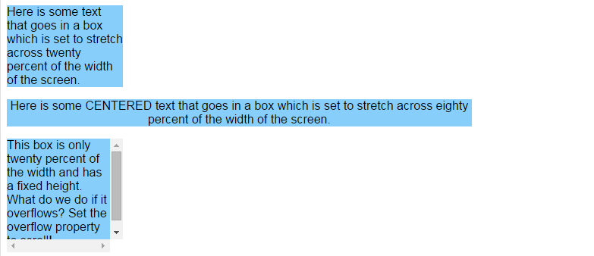
Element Dimensions
<!DOCTYPE html>
<html>
<head>
<meta charset = "utf-8">
<title>Box Dimensions</title>
<style type = "text/css">
p { background-color: LightSkyBlue;
margin-bottom: .5em;
font-family: arial, helvetica, sans-serif; }
</style>
</head>
<body>
<p style = "width: 20%;">Here is some
text that goes in a box which is
set to stretch across twenty percent
of the width of the screen.</p>
<p style = "width: 80%; text-align: center;">
Here is some CENTERED text that goes in a box
which is set to stretch across eighty percent of
the width of the screen.</p>
<p style = "width: 20%; height: 150px; overflow: scroll;">
This box is only twenty percent of
the width and has a fixed height.
What do we do if it overflows? Set the
overflow property to scroll!</p>
</body>
</html>

Slide 48
Element Dimensions
Dimensions of elements on a page can be set with CSS by using properties height and width
Their values can be relative or absolute
overflow Property and Scroll Bars
Problem with setting both vertical and horizontal dimensions of an element
Content might sometimes exceed the set boundaries, in which case the element must be made large enough for all the content to fit
Can set the overflow property to scroll, which adds scroll bars if the text overflows the boundaries set for it

Slide 49
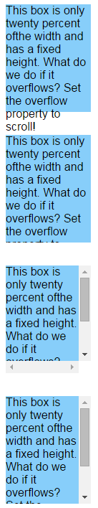
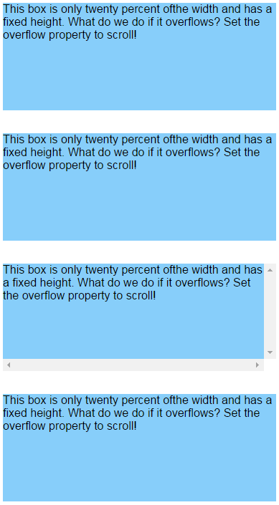
Element Dimensions
visible: 內容不會被刪除, 會超出元素外
hidden: 內容會被刪除, 元素保持設定大小
scroll: 支援scroll bar
auto: 需要時才會出現scroll bar
<!DOCTYPE html>
<html>
<head>
<meta charset = "utf-8">
<title>Box Dimensions</title>
<style type = "text/css">
p { background-color: LightSkyBlue;
margin-bottom: 2em;
font-family: arial, helvetica, sans-serif; }
</style>
</head>
<body>
<p style = "width: 20%; height: 150px; overflow: visible;">
This box is only twenty percent ofthe width and has a fixed height.
What do we do if it overflows? Set the overflow property to scroll!</p>
<p style = "width: 20%; height: 150px; overflow: hidden;">
This box is only twenty percent ofthe width and has a fixed height. What do we do if it overflows? Set the overflow property to scroll!</p>
<p style = "width: 20%; height: 150px; overflow: scroll;">
This box is only twenty percent ofthe width and has a fixed height. What do we do if it overflows? Set the overflow property to scroll!</p>
<p style = "width: 20%; height: 150px; overflow: auto;">
This box is only twenty percent ofthe width and has a fixed height. What do we do if it overflows? Set the overflow property to scroll!</p>
</body>
</html>

Slide 50
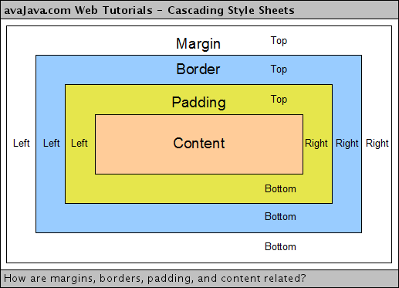
Box Model and Text Flow
Block-level HTML5 elements have a virtual box drawn around them based on the box model
When the browser renders an element using the box model, the content is surrounded by padding, a margin and a border.
Ref : http://www.avajava.com/tutorials/lessons/how-are-margins-borders-padding-and-content-related.html

Slide 51
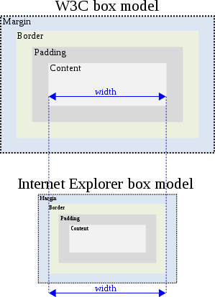
Box Model and Text Flow
Internet Explorer box model bug
Version :IE6-
Ref : http://en.wikipedia.org/wiki/Internet_Explorer_box_model_bug

Slide 52
Box Model and Text Flow
Padding
The padding property determines the distance between the content inside an element and the edge of the element
Padding be set for each side of the box by using padding-top, padding-right, padding-left and padding-bottom
Margin
Determines the distance between the element’s edge and any outside text
Margins for individual sides of an element can be specified by using margin-top, margin-right, margin-left and margin-bottom

Slide 53
Box Model and Text Flow
Border
border-width
May be set to any of the CSS lengths or to the predefined value of thin, medium or thick
border-color
Sets the color used for the border
border-style
Options are: none, hidden, dotted, dashed, solid, double, groove, ridge, inset and outset
CSS controls the border using three properties: border-width, border-color and border-style.

Slide 54
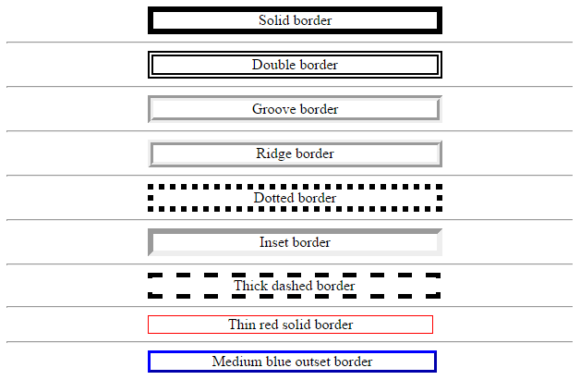
Box Model and Text Flow
!DOCTYPE html>
<html>
<head>
<meta charset = "utf-8">
<title>Borders</title>
<style type = "text/css">
div { text-align: center;
width: 50%;
position: relative;
left: 25%;
border-width: 6px; }
.thick { border-width: thick; }
.medium { border-width: medium; }
.thin { border-width: thin; }
.solid { border-style: solid; }
.double { border-style: double; }
.groove { border-style: groove; }
.ridge { border-style: ridge; }
.dotted { border-style: dotted; }
.inset { border-style: inset; }
.outset { border-style: outset; }
.dashed { border-style: dashed; }
.red { border-color: red; }
.blue { border-color: blue; }
</style>
</head>
<body>
<div class = "solid">Solid border</div><hr>
<div class = "double">Double border</div><hr>
<div class = "groove">Groove border</div><hr>
<div class = "ridge">Ridge border</div><hr>
<div class = "dotted">Dotted border</div><hr>
<div class = "inset">Inset border</div><hr>
<div class = "thick dashed">Thick dashed border</div><hr>
<div class = "thin red solid">Thin red solid border</div><hr>
<div class = "medium blue outset">Medium blue outset border</div>
</body>
</html>
25%
50%

Slide 55


Box Model and Text Flow
<!DOCTYPE html>
<html>
<head>
<meta charset = "utf-8">
<title>Flowing Text Around Floating Elements</title>
<style type = "text/css">
header { background-color: SkyBlue;
text-align: center;
font-family: arial, helvetica, sans-serif;
padding: .2em; }
p { text-align: justify;
font-family: verdana, geneva, sans-serif;
margin: .5em; }
h1 { margin-top: 0px; }
.floated { background-color: LightGrey;
font-size: 1.5em;
font-family: arial, helvetica, sans-serif;
padding: .2em;
margin-left: .5em;
margin-bottom: .5em;
float: right;
text-align: right;
width: 50%; }
section { border: 1px solid skyBlue; }
</style>
</head>
<body>
<header><img src = "deitel.png" alt = "Deitel" /></header>
<section>
<h1 class = "floated">Corporate Training and Authoring</h1>
<p>Deitel & Associates, Inc. is an internationally recognized corporate training and authoring
organization specializing in programming languages, Internet/web technology, iPhone and Android
app development and object technology education. The company provides courses on Java, C++, C#,
Visual Basic, C, Internet and web programming, Object Technology and iPhone and Android app
development.</p>
</section>
<section>
<h1 class = "floated">Programming Books and Videos</h1>
<p>Through its publishing partnership with Pearson, Deitel & Associates, Inc. publishes
leading-edge programming textbooks, professional books and interactive web-based and DVD
LiveLessons video courses.</p>
</section>
</body>
</html>
deitel.png

Slide 56
<style type = "text/css">
header { background-color: SkyBlue;
text-align: center;
font-family: arial, helvetica, sans-serif;
padding: .2em; }
p { text-align: justify;
font-family: verdana, geneva, sans-serif;
margin: .5em; }
h1 { margin-top: 0px; }
.floated { background-color: LightGrey;
font-size: 1.5em;
font-family: arial, helvetica, sans-serif;
padding: .2em;
margin-left: .5em;
margin-bottom: .5em;
float: right;
text-align: right;
width: 50%; }
section { border: 1px solid skyBlue; }
</style>
.2em
0px
.5em
.5em
.5em
.5em
.5em

Slide 57
Box Model and Text Flow
float
Floating allows you to move an element to one side of the screen; other content in the document then flows around the floated element.
none
left
right
Absolutely positioned elements ignores the float property!

Slide 58
Padding / Margin
Padding
padding-top, padding-right, padding-left and padding-bottom
Margin
margin-top, margin-right, margin-left and margin-bottom
padding: 20px;
/* 上下左右皆 20px */
padding: 16px 20px;
/* 上下 16px ，左右 20px */
padding: 10px 30px 20px;
/* 上 10px ，左右 30px, 下 20px */
padding: 10px 3px 30px 5px;
/* 依序圍上、右、下、左，順時針方向 */

Slide 59

Padding / Margin
padding: 10px; /* 上下左右皆 10px */
padding: 10px 20px; /* 上下 10px 左右 20px */
padding: 10px 20px 30px; /* 上 10px 左右 20px 下 30px */
padding: 10px 20px 30px 40px; /* 上 10px 右 20px 下 30px 左 40px */
margin: 10px; /* 上下左右皆 10px */
margin: 10px 20px; /* 上下 16px ，左右 20px */
margin: 10px 20px 30px; /* 上 10px 左右 20px 下 30px */
margin: 10px 20px 30px 40px; /* 上 10px 右 20px 下 30px 左 40px */
margin: 10px auto; /* 上下 10px 左右由瀏覽器設定 */
margin: auto; /* 由瀏覽器設定 */
20px
80px
40px
padding : 20px 40px 60px 80px;
60px

Slide 60
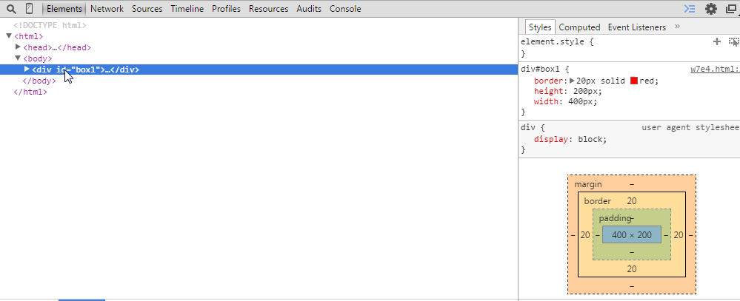
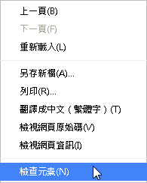
Padding / Margin
Chrome

Slide 61
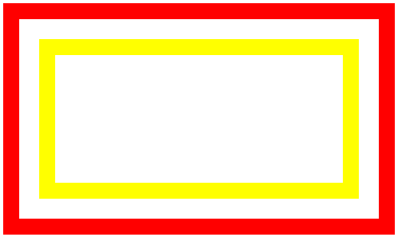
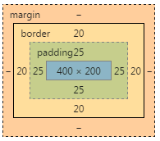
Padding / Margin
div#box1
{
border: 20px solid red;
height : 200px;
width : 400px;
padding : 25px;
}
div#box2
{
border: 20px solid yellow;
height :…;
width : …;
}
<div id = "box1">
<div id = "box2">
</div>
</div>
div#box1

Slide 62
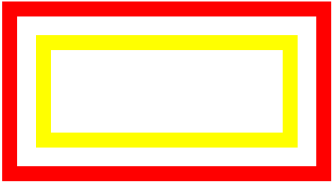
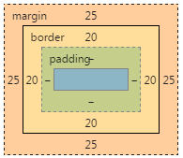
Padding / Margin
div#box1
{
border: 20px solid red;
height : 200px;
width : 400px;
}
div#box2
{
border: 20px solid yellow;
margin: 25px;
height :…;
width : …;
}
<div id = "box1">
<div id = "box2">
</div>
</div>
div#box2

Slide 63
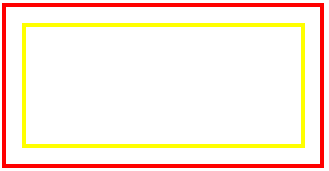
Exercise
Hint :
padding or margin
<div id="box1"> <div id="box2"></div></div>
20px
box1 {
width : 400px;
height: 200px;
border : 5px solid red;
…
}
box2 {
border : 5px solid yellow;
…
}

Slide 64
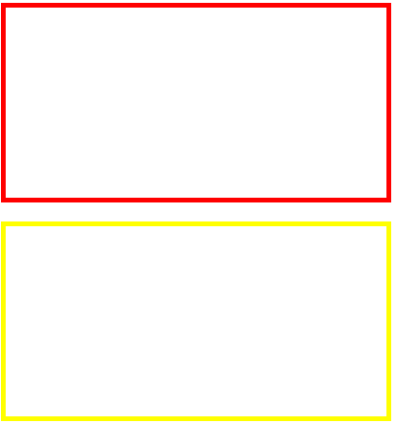
Exercise
Hint :
padding or margin
<div id="box1"></div><div id="box2"></div>
box1 {
width : 400px;
height: 200px;
border : 5px solid red;
…
}
box2 {
width : 400px;
height: 200px;
border : 5px solid yellow;
…
}
20px

Slide 65
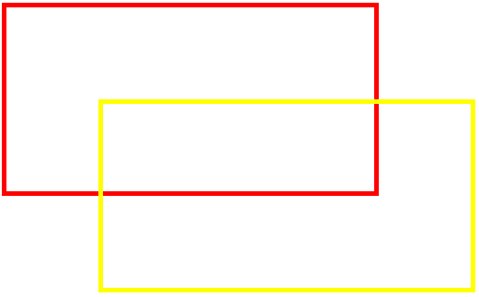
Exercise
Hint :
position
<div id="box1"> </div><div id="box2"></div>
box1 {
width : 400px;
height: 200px;
border : 5px solid red;
…
}
box2 {
width : 400px;
height: 200px;
border : 5px solid yellow;
…
}
100px
100px

Slide 66
Exercise
Hint :
padding or margin
<div id="box1"> </div><div id="box2"></div>
box1 {
width : 400px;
height: 200px;
border : 5px solid red;
…
}
box2 {
width : 400px;
height: 200px;
border : 5px solid yellow;
…
}
100px
100px

Slide 67

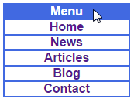
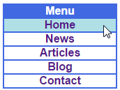
Drop-Down Menus
<!DOCTYPE html>
<html>
<head>
<meta charset = "utf-8">
<title>Drop-Down Menu</title>
<style type = "text/css">
body { font-family: arial, sans-serif }
nav { font-weight: bold;
color: white;
border: 2px solid RoyalBlue;
text-align: center;
width: 10em;
background-color: RoyalBlue; }
nav ul { display: none;
list-style: none;
margin: 0;
padding: 0; }
nav:hover ul { display: block; }
nav ul li { border-top: 2px solid RoyalBlue;
background-color: white;
width: 10em;
color: black; }
nav ul li:hover { background-color: PowderBlue; }
a { text-decoration: none; }
</style>
</head>
<body>
<nav>Menu
<ul>
<li><a href = "#">Home</a></li>
<li><a href = "#">News</a></li>
<li><a href = "#">Articles</a></li>
<li><a href = "#">Blog</a></li>
<li><a href = "#">Contact</a></li>
</ul>
</nav>
</body>
</html>

Slide 68
Drop-Down Menus
display property
block
Displays an element as a block element (like <p>)
inline
Displays an element as an inline element (like <span>)
none
The element will not be displayed at all

Slide 69

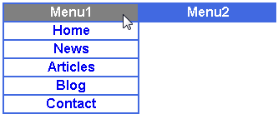
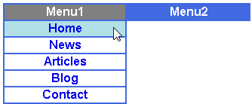
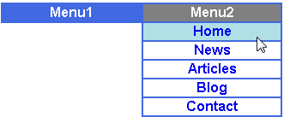
Exercise
Hint :
float
a:hover
display

Slide 70
Media Types and Media Queries
CSS media types
allow you to decide what a page should look like depending on the kind of media being used to display the page
Most common media type for a web page is the screen media type, which is a standard computer screen

Slide 71
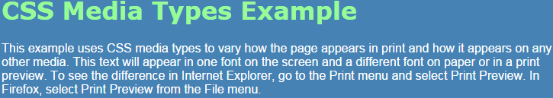
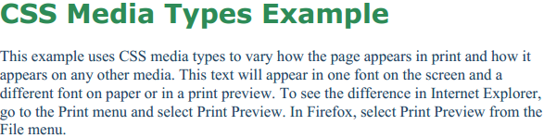
Media Types and Media Queries
<!DOCTYPE html>
<html>
<head>
<meta charset = "utf-8">
<title>Media Types</title>
<style type = "text/css">
@media all
{
body { background-color: SteelBlue; }
h1 { font-family: verdana, helvetica, sans-serif;
color: PaleGreen; }
p { font-size: 12pt;
color: white;
font-family: arial, sans-serif; }
} /* End @media all declaration. */
@media print
{
body { background-color: white; }
h1 { color: SeaGreen; }
p { font-size: 14pt;
color: SteelBlue;
font-family: "times new roman", times, serif; }
} /* End @media print declaration. */
</style>
</head>
<body>
<h1>CSS Media Types Example</h1>
<p>
This example uses CSS media types to vary how the page appears in print and how it
appears on any other media. This text will appear in one font on the screen and a
different font on paper or in a print preview. To see the difference in Internet
Explorer, go to the Print menu and select Print Preview. In Firefox, select Print
Preview from the File menu.
</p>
</body>
</html>

Slide 72
Media Types and Media Queries
Media Types
all
all media type devices
handheld
small or mobile Internet devices
print
printers
screen
standard computer screen

Slide 73
Media Types and Media Queries
Media Types
speech
speech and sound synthesizers
braille
braille tactile feedback devices
embossed
paged braille printers
projection
projected presentations, like slides
tty
media using a fixed-pitch character grid, like teletypes and terminals
tv
television-type devices

Slide 74
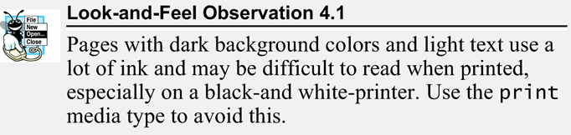
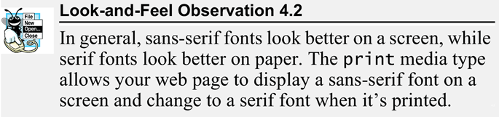
Media Types and Media Queries

Slide 75
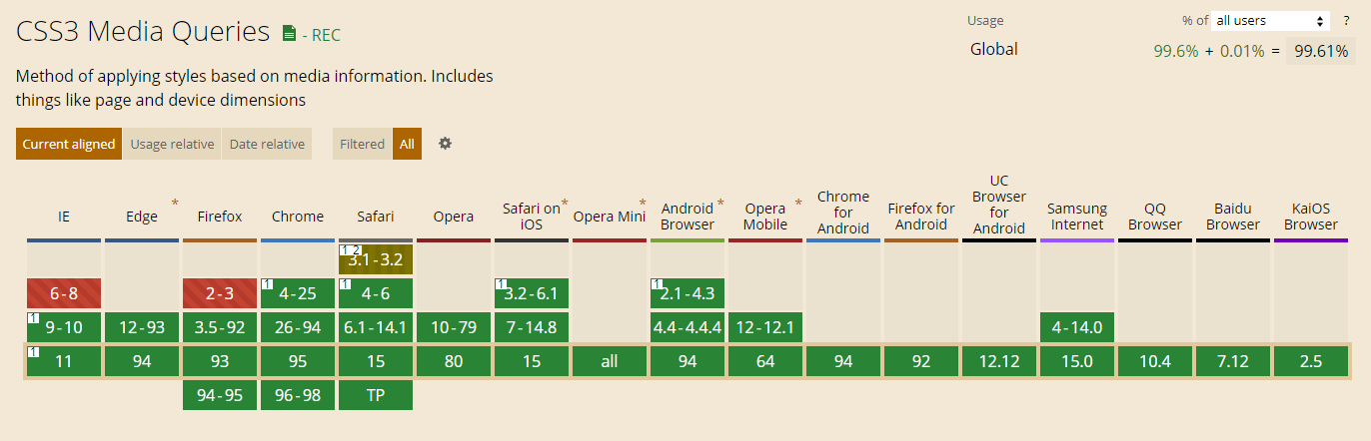
Media Types and Media Queries
Allow you to format your content to specific output devices.
Include a media type and expressions that check the media features of the output device.
IE8- not supported
Ref: http://caniuse.com/#feat=css-mediaqueries

Slide 76

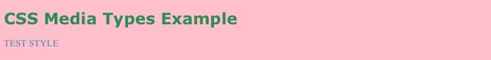
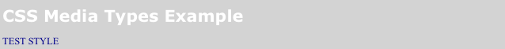
Media Types and Media Queries
<!DOCTYPE html>
<html>
<head>
<meta charset = "utf-8">
<title>Media Types</title>
<style type = "text/css">
@media screen
{
body { background-color: SteelBlue; }
h1 { font-family: verdana, helvetica, sans-serif;
color: PaleGreen; }
p { font-size: 12pt;
color: white;
font-family: arial, sans-serif; }
} /*for PC*/
@media screen and (device-width: 375px) and (device-height: 812px) and (-webkit-device-pixel-ratio: 3)
{
body { background-color: pink; }
h1 { color: SeaGreen; }
p { font-size: 14pt;
color: SteelBlue;
font-family: "times new roman", times, serif; }
}/* for iphone X, iphone 12 mini*/
@media screen and (device-width: 394px) and (device-height: 844px) and (-webkit-device-pixel-ratio: 3)
{
body { background-color: LightGrey ; }
h1 { color: white; }
p { font-size: 14pt;
color: DarkBlue;
font-family: "times new roman", times, serif; }
} /* for iphone 13*/
</style>
</head>
<body>
<h1>CSS Media Types Example</h1>
<p>TEST STYLE</p>
</body>
</html>

Slide 77
Media Types and Media Queries
Common media features
width / height with max/min prefix
the width / height of the part of the screen on which the document is rendered, including any scrollbars
device-width / device-height with max/min prefix
the width / height of the screen of the output device
orientation
if the height is greater than the width, orientation is portrait, and if the width is greater than the height, orientation is landscape
aspect-ratio with max/min prefix
the ratio of width to height
device-aspect-ratio with max/min prefix
the ratio of device-width to device-height

Slide 78
Media Types and Media Queries
WebKit is a layout engine software component for rendering web pages in web browsers. It powers Apple's Safari web browser and was previously used in Google's Chrome web browser.

Slide 79
Media Types and Media Queries
Specific device
http://cssmediaqueries.com/target/
https://webdevpuneet.com/iphone-x-8-8-plus-media-queries-css/
https://css-tricks.com/snippets/css/media-queries-for-standard-devices/
An example for mobile :
@media screen and (min-device-width: 200px) and (max-device-width: 600px)
/* 200px < device-width < 600px */

Slide 80
Browser Detect
Use Javascript
http://www.quirksmode.org/js/detect.html
Use HTML
https://msdn.microsoft.com/en-us/library/ms537512(VS.85).aspx#dlrevealed

Slide 81
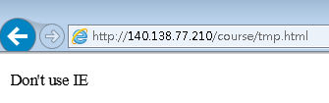
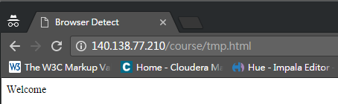
Browser Detect
<!DOCTYPE html>
<html>
<head>
<meta charset = "utf-8">
<title>Browser Detect</title>
</head>
<body>
<!--[if IE]> Don't use IE <![endif]-->
<!--[if !IE]><!--> Welcome <!--<![endif]-->
</body>
</html>

Slide 82
User Style Sheets
Users can define their own user style sheets to format pages based on their preferences
Absolute font size measurements override user style sheets, while relative font sizes will yield to a user-defined style
User style sheets are not linked to a document; rather, they are set in the browser’s options

Slide 83
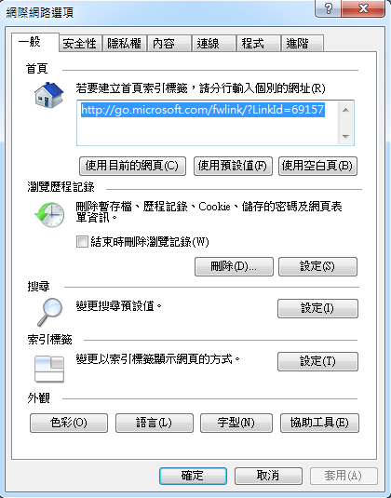
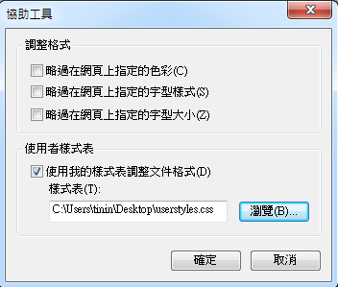
User Style Sheets
IE/Edge
Step 2: click
Step 1: click

Slide 84
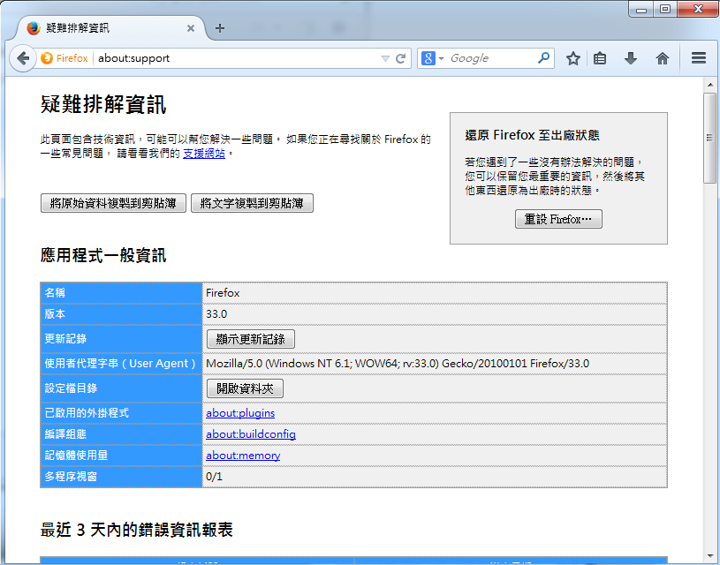
User Style Sheets
Firefox
Step1: URL = about:support
Step2: click

Slide 85
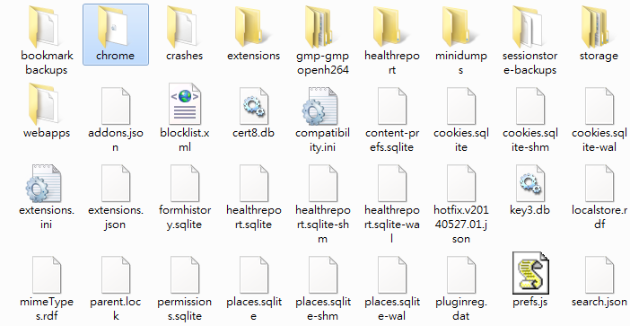
User Style Sheets
Firefox
Step3: add the folder "chrome" and then open it

Slide 86
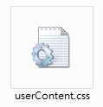
User Style Sheets
Firefox
Step 4:
Edit your style sheets and name as "userContent.css"
Step 5:
Reopen Firefox

Slide 87
User Style Sheets
Chrome :
User style sheets support removed in Chrome 33+

Slide 88


User Style Sheets
<!DOCTYPE html>
<html>
<head>
<meta charset = "utf-8">
<title>User Styles</title>
<style type = "text/css">
.note { font-size: 9pt; }
</style>
</head>
<body>
<p>Thanks for visiting my website. I hope you enjoy it. </p>
<p class = "note">Please Note: This site will be
moving soon. Please check periodically for updates.</p>
</body>
</html>
userstyle.css
body { font-size: 20pt;
color: yellow;
background-color: Navy; }

Slide 89

User Style Sheets
<!DOCTYPE html>
<html>
<head>
<meta charset = "utf-8">
<title>User Styles</title>
<style type = "text/css">
.note { font-size: .75em; }
</style>
</head>
<body>
<p>Thanks for visiting my website. I hope you enjoy it. </p>
<p class = "note">Please Note: This site will be
moving soon. Please check periodically for updates.</p>
</body>
</html>
userstyle.css
body { font-size: 20pt;
color: yellow;
background-color: Navy; }

Slide 90
Q&A

